Slide 1
TAP Spring 2019
Ariel Thomas, Anderson Molter, Ephraim Kim

Slide 2
What is the Technology Ambassadors Program (TAP)?
Is an elective where groups of 3-4 students develop educational or demonstrative technology for students K-12.
Is about outreach and participating in events targeted to various groups of students, kids, and the general public.
Is about improving technical, communication, and leadership skills by working on projects and presenting together as teams

Slide 3
Project timeline: Forming groups, discussing ideas, learning
Discussed engines: PICO/Game Maker Studio/Unity, researched games and capabilities on the engines
Began and continued work on game. Started with PICO-8. On the 18th, we ditched PICO and moved to Unity.
COZMO/Sphero, viewed demos from past teams.
18–29 Jan.
18–29 Jan.
2–10 Mar.
1–17 Jan.
18–29 Jan.
31 Jan. – 28 Feb.
Formed teams, discussed game ideas (arena fighting game, racing game, small arcade games a la tron/snake/etc…)
Settled on multiplayer as a core feature to pursue
Gave presentation of the game concepts and the engines, received feedback
Spring break
Heavy amount of work accomplished during the break; TAP Expo coming up on 14th

Slide 4
The TAP Expo, Fixing a broken game
TAP Expo
Control system broken
Nobody able to play the game
Found solution involving rotating a third controller at all times, which allowed two players to play the game
14–22 Mar.
14 Mar.
22 Mar.
Fixed controls
Fixed attacking system
Fixed respawn system
Fixed level selection and character selection

Slide 5
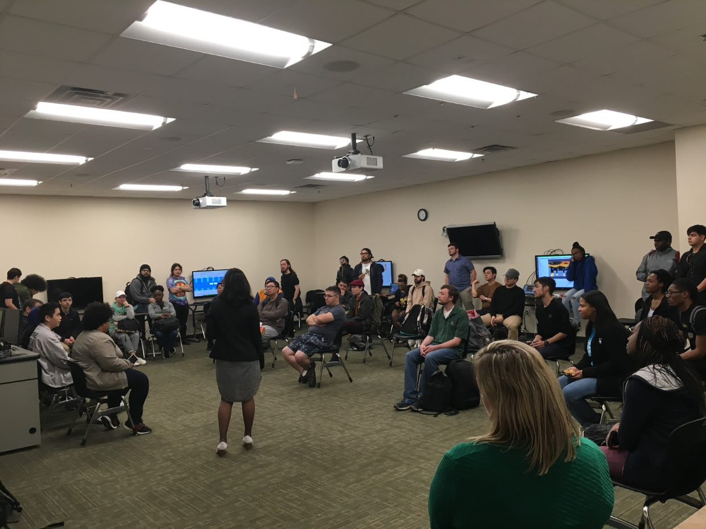
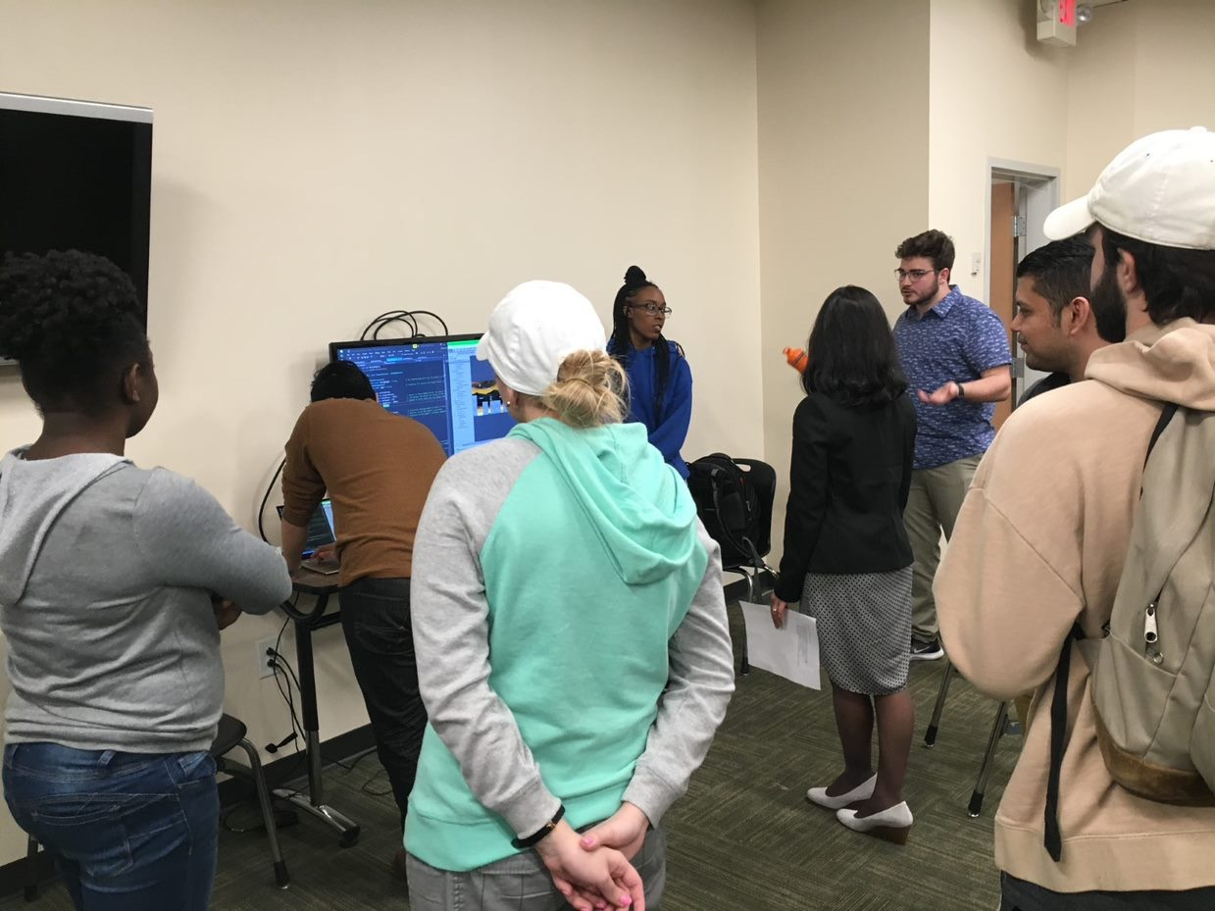
TAP EXPO

Slide 6
Atlanta Science Festival, a new control system, and finding success
Atlanta Science Festival
14 commits since 14th
Huge success. Universally enjoyed by kids (approx. ages 7-13).
First time we got four players to play the game (original idea)
Huge success with the middle schoolers
23 Mar.
23 Mar.
10 Apr. and 13 Apr. (STarS and S3)
Few more bug fixes
Got a new control system called Rewired from Unity Asset Store; this enabled four player gameplay

Slide 7
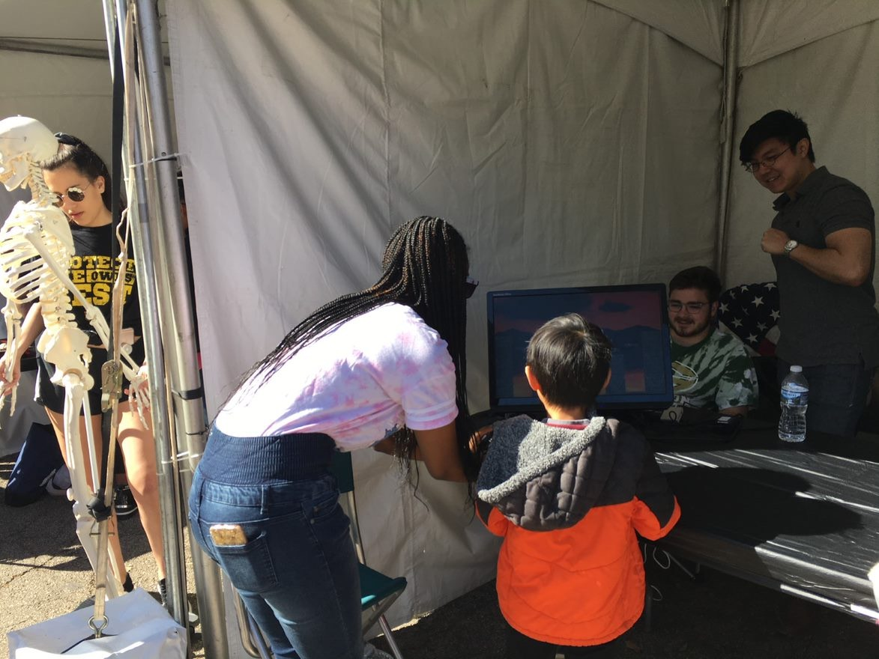
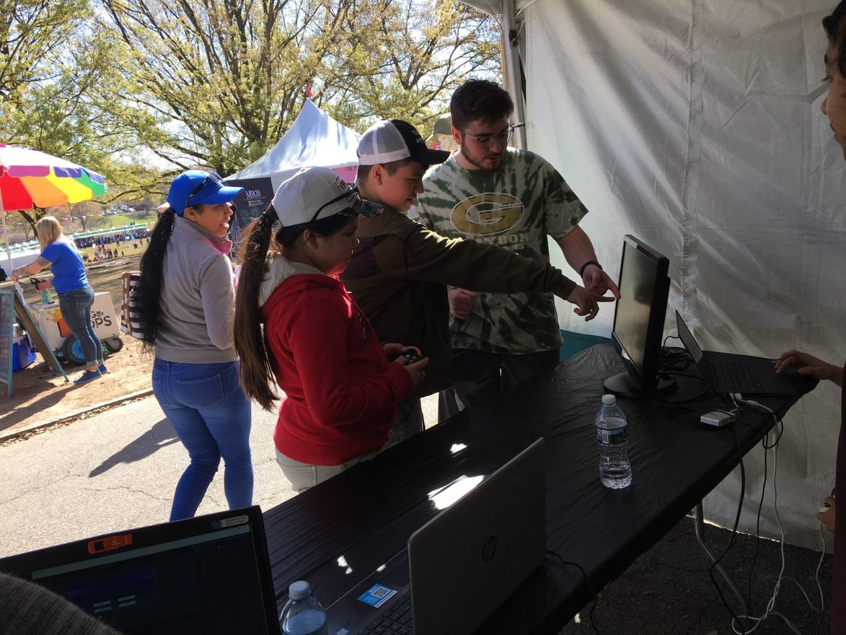
ATLANTA SCIENCE FESTIVAL

Slide 8
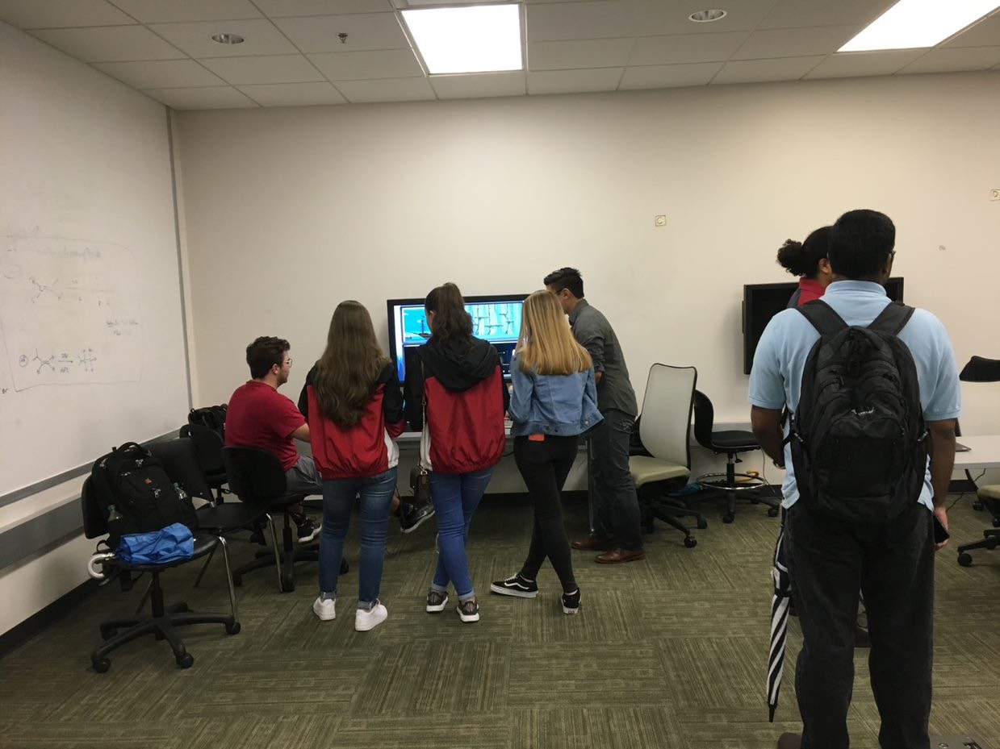
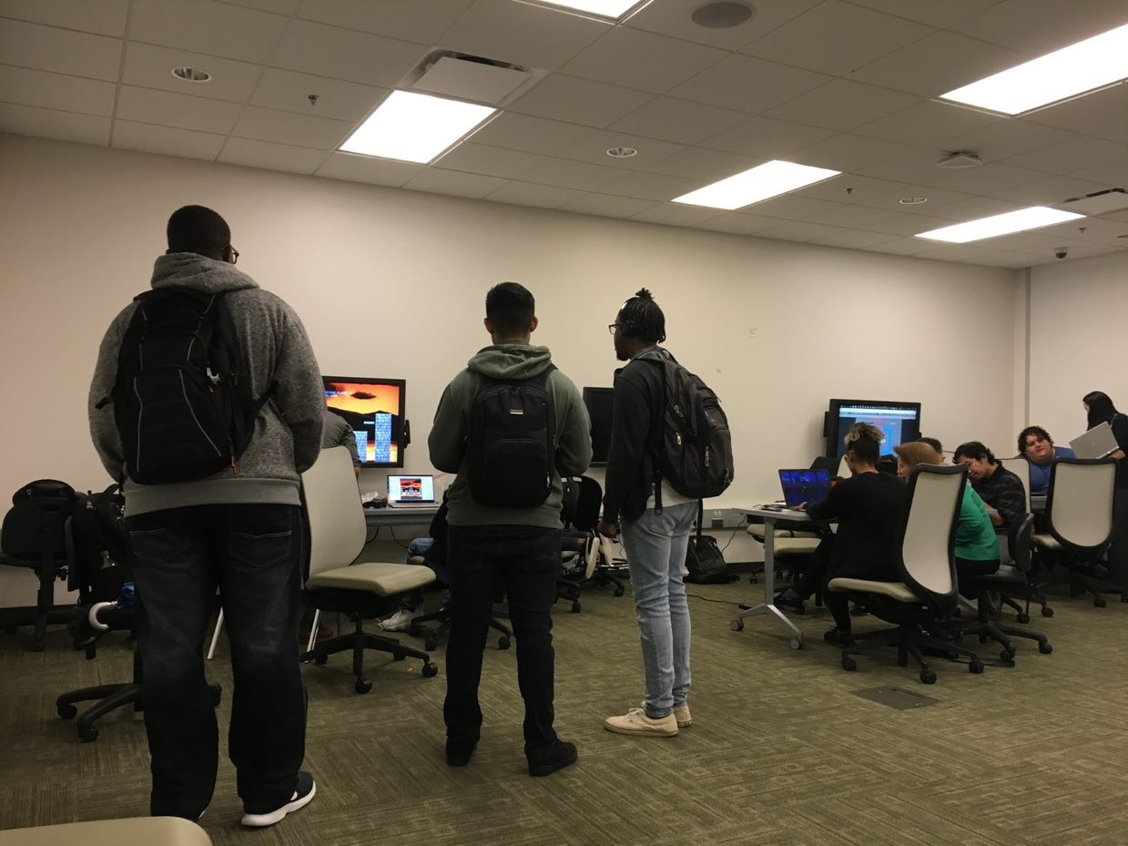
STARS Event

Slide 9
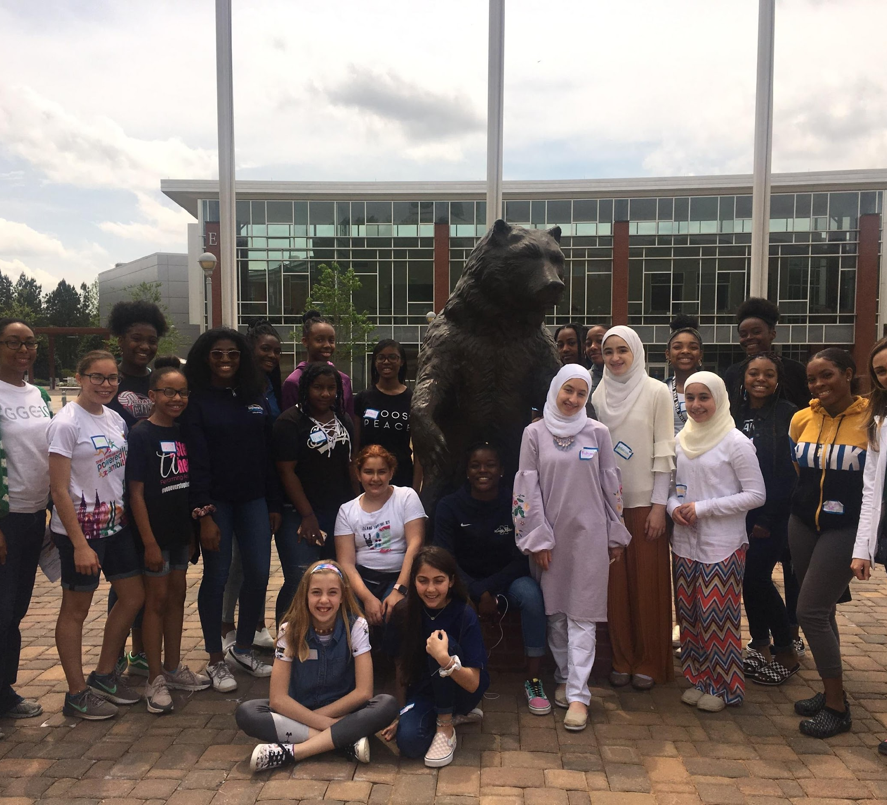
Super Saturday Series (S3)

Slide 10
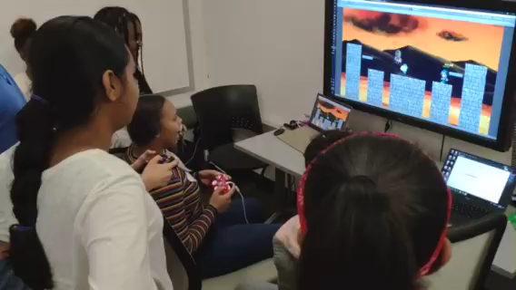

Slide 11
Technologies

Slide 12
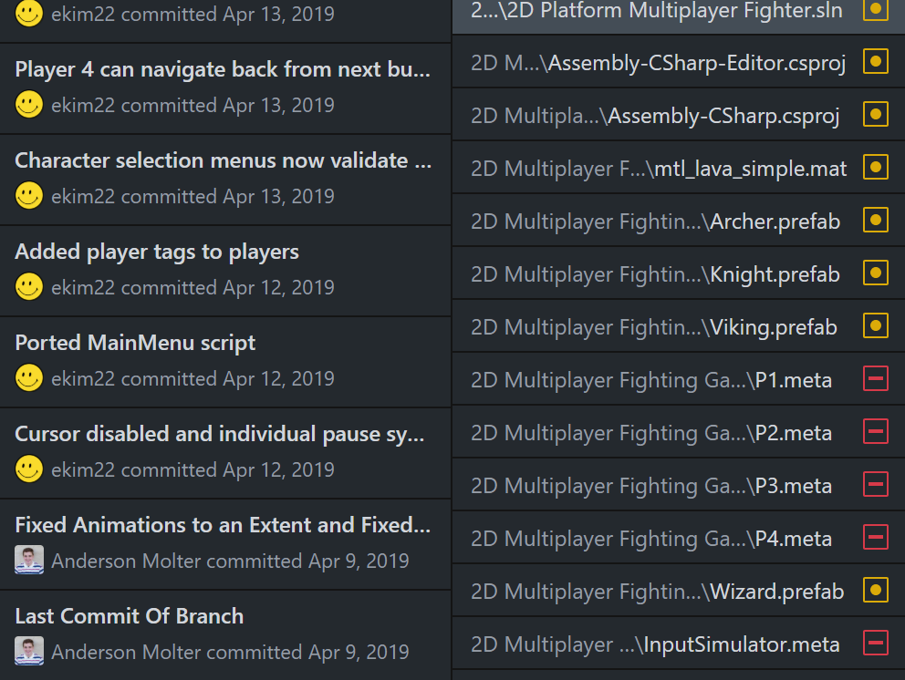
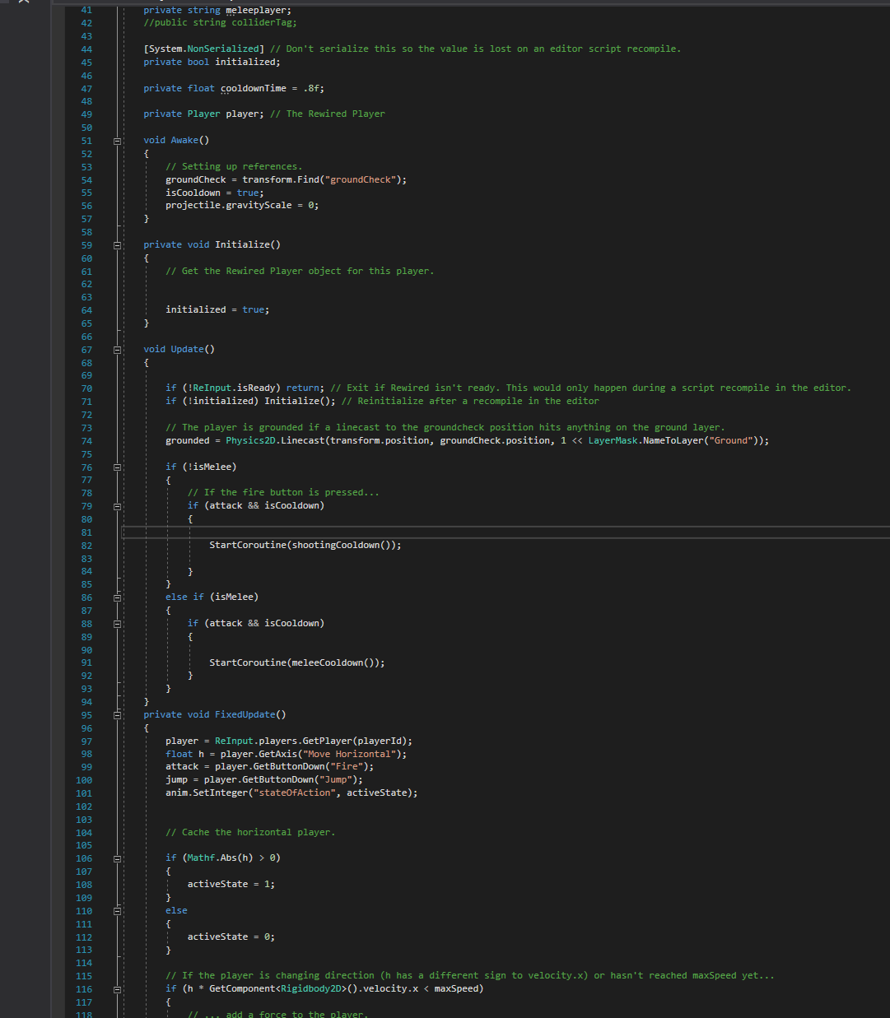
Technologies
C# and Visual Studio for coding
GitHub for organization and version control

Slide 13

Visual Studio IDE
Free Development Platform for C#, C++/CLI, Visual Basic .NET, F#, JavaScript, XML,XSLT, HTML, and CSS.
Made by Microsoft
Allows users to make Native Windows Applications for Windows Store.

Slide 14
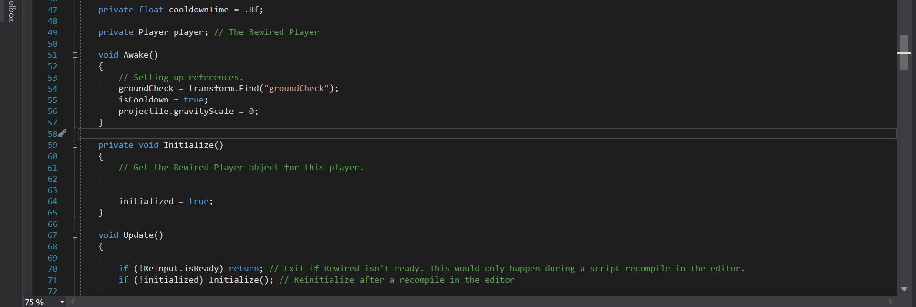
C#
Microsoft’s “Java”
The syntax of C# language is similar to the C-style family like Java, C, C++.
C# and XAML are the main language used to develop Windows Store Apps.

Slide 15
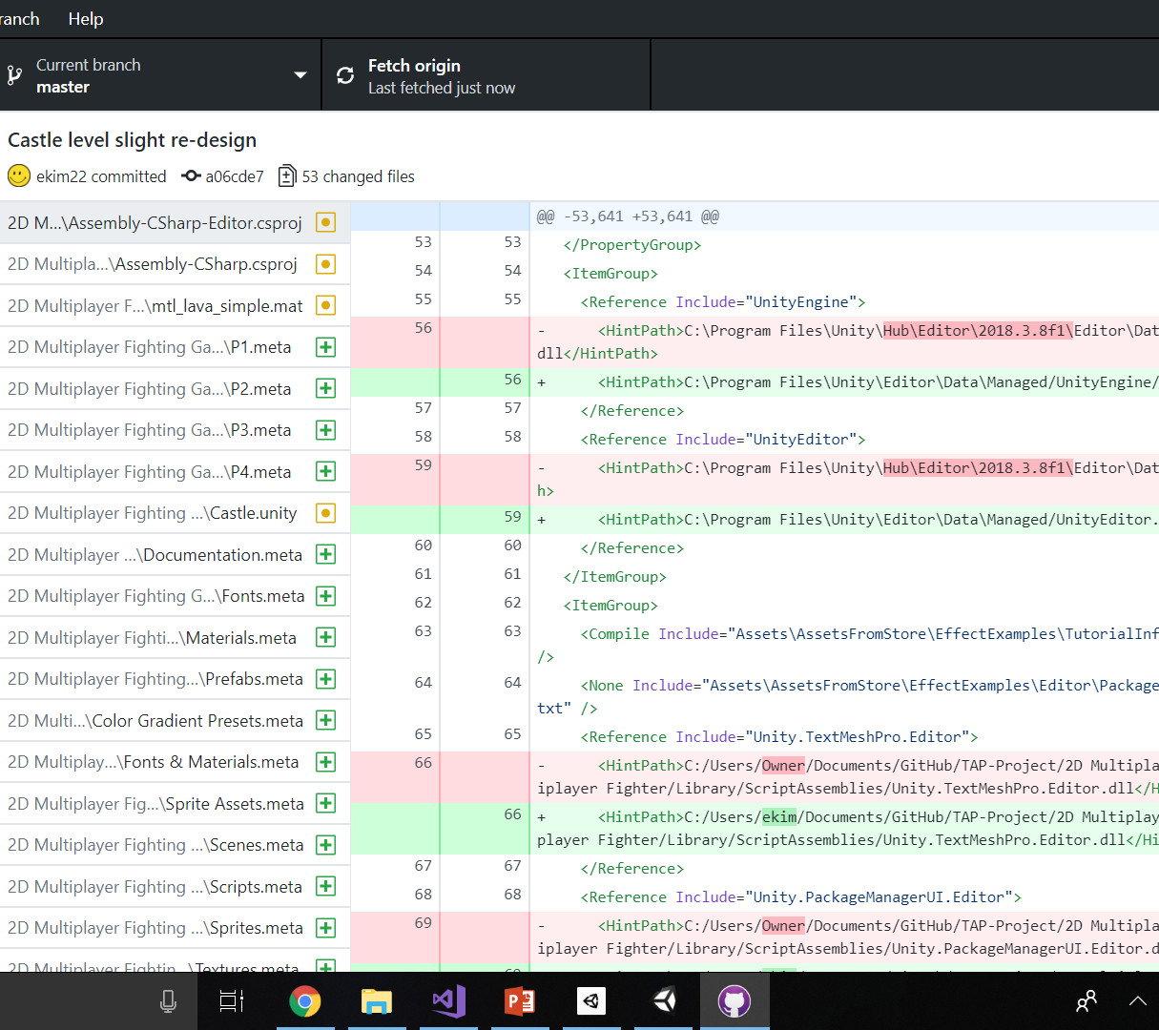
GitHub
Provides professional repository services for project collaboration.
Free Pro account with Student Email.
Makes merging versions of software a breeze (usually).

Slide 16
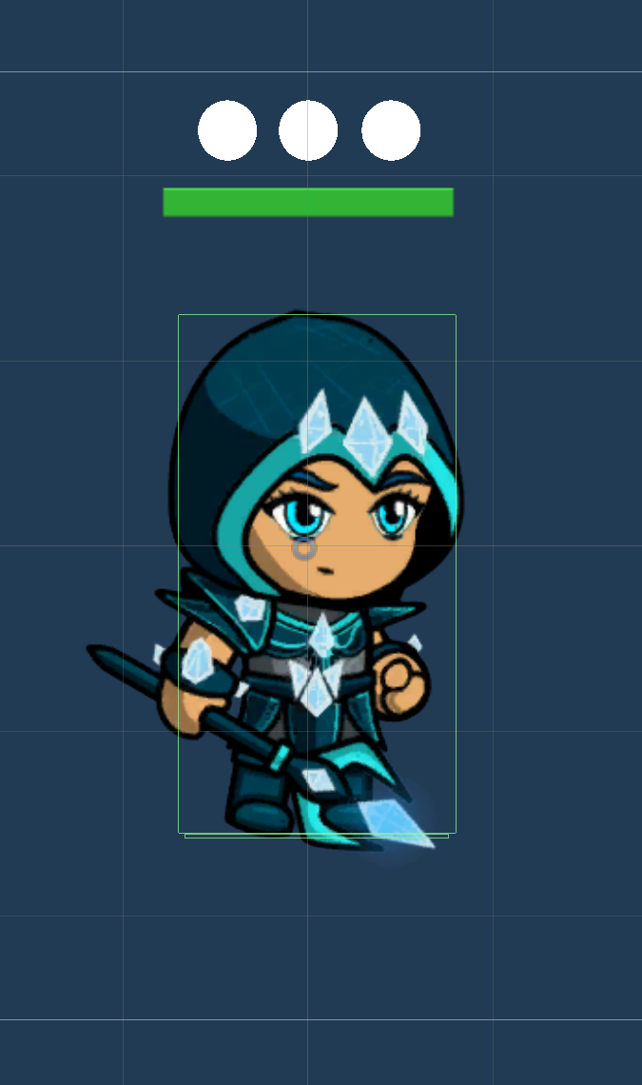
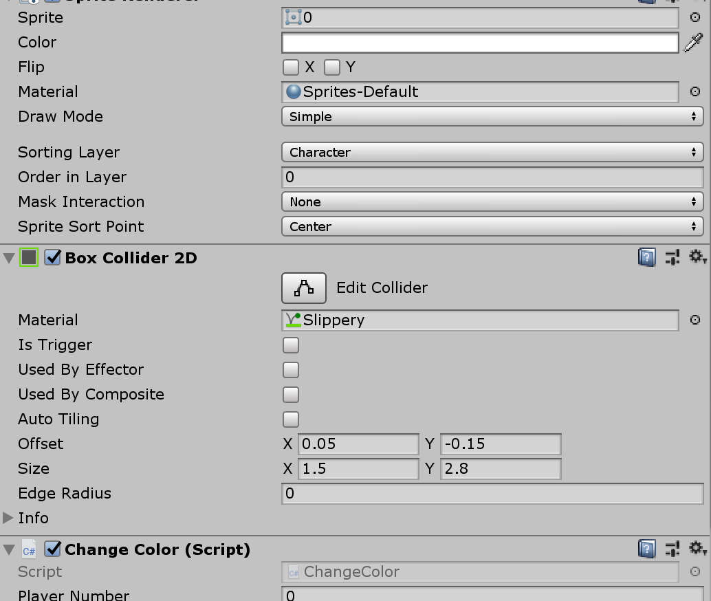
Prefabs and Components
Prefabs are a way to reuse GameObjects
Components are attributes on GameObjects and a way to manage their properties and additions.

Slide 17
Gameplay

Slide 18
Workshop Tutorials

Slide 19
Introducing Digital Media and ITEC 1001 classes to Unity and Coding
A Paper Airplane’s journey, a short tutorial introducing Unity basics to instill confidence.
Setting up a Unity Sprite
Learning about GameObjects such as hitboxes and colliders
Getting acquainted with real code and developing movement logic to the sprite.
Adding components to a GameObject using the inspector feature

Slide 20
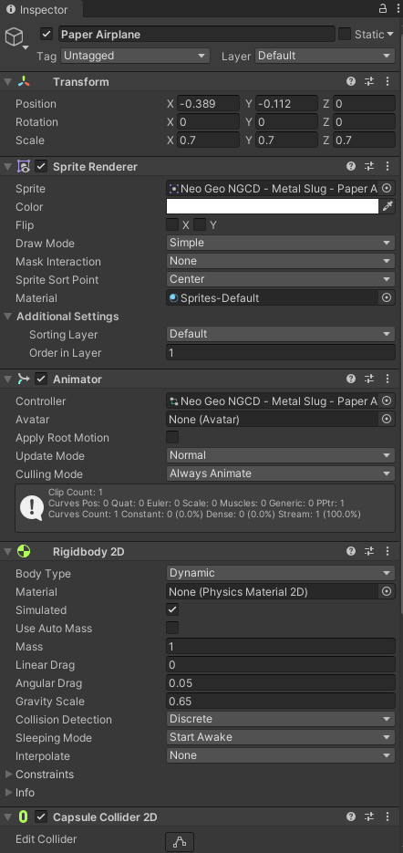
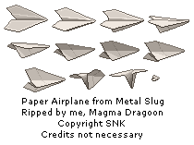
First Tutorial
Paper Airplane Sprite (top left)
Editor, scene view, hierarchy of gameobjects (bottom)
Inspector, components (top right)

Slide 21
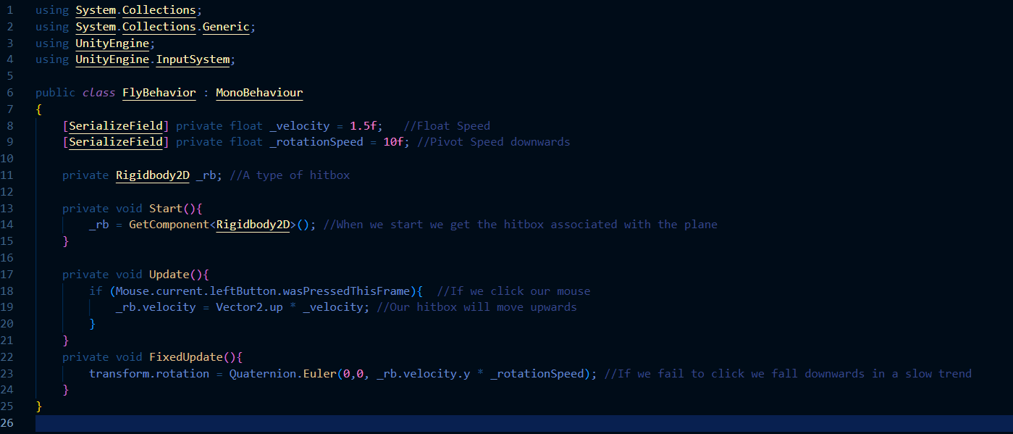
Paper Airplane Movement Code

Slide 22
Lessons Learned

